Slide 1
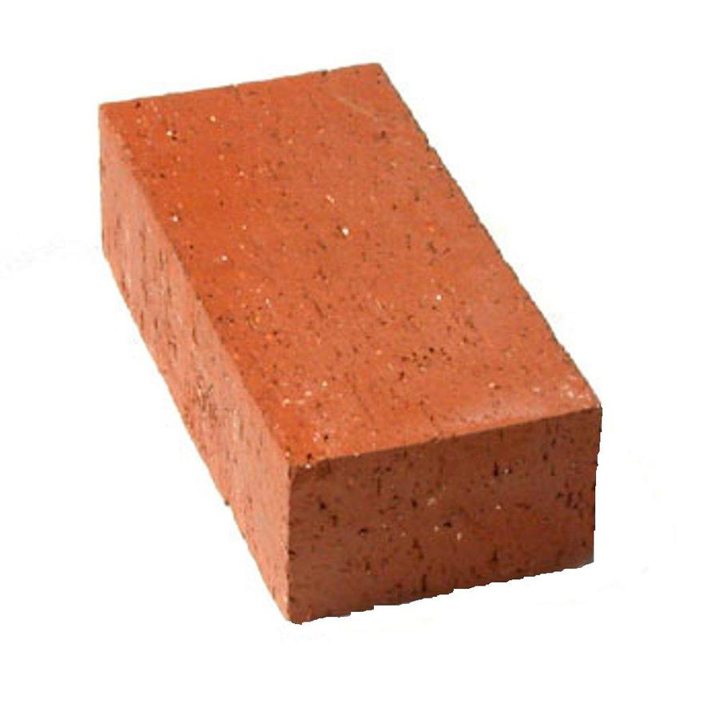
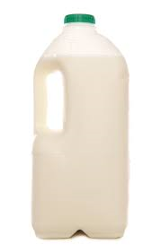
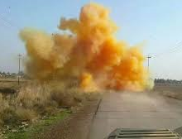
Daily Review
There are three main states of matter. They can be described in terms of volume, shape and compressibility.
Solids
Fixed volume
Fixed shape
Are incompressible
Liquids
Fixed volume
Variable shape
Are incompressible
Gases
Variable volume
Variable shape
Are compressible

Slide 2
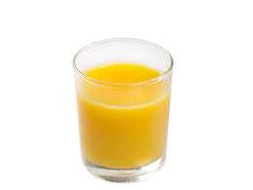
Daily Review
Steps for describing the state of matter
Step 1: Describe its shape (fixed or variable)
Step 2: Describe its volume (fixed or variable)
Step 3: Describe its compressibility (compressible or incompressible)
What state is juice?
Explain your decision using the terms volume, shape and compressible.
_________ is a _________ because it has a _________ shape, a _________ volume and are _______________.

Slide 3
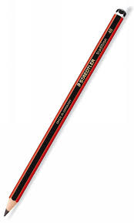
Daily Review
Steps for describing the state of matter
Step 1: Describe its shape (fixed or variable)
Step 2: Describe its volume (fixed or variable)
Step 3: Describe its compressibility (compressible or incompressible)
What state is a pencil?
Explain your decision using the terms volume, shape and compressible.
_________ is a _________ because it has a _________ shape, a _________ volume and are _______________.

Slide 4
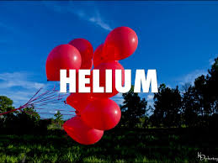
Daily Review
Steps for describing the state of matter
Step 1: Describe its shape (fixed or variable)
Step 2: Describe its volume (fixed or variable)
Step 3: Describe its compressibility (compressible or incompressible)
What state is helium inside balloons?
Explain your decision using the terms volume, shape and compressible.
_________ is a _________ because it has a _________ shape, a _________ volume and are _______________.

Slide 5
Phase Changes

Slide 6
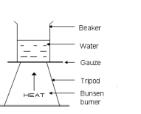
Learning Objectives
Vocabulary
Explain: give a reason for
Name the phase changes between the three common states of matter
Explain how phase changes occur
CFU
What are we going to learn?
Activate Prior Knowledge
Remember when you put water in a beaker and heated it with a Bunsen burner. What did you see?

Slide 7
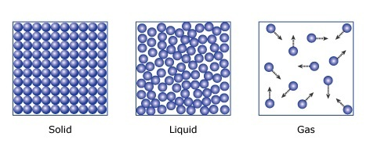
Concept Development
CFU 1
What process turns a solid into a liquid?
Substances can change between the three states
CHANGES BETWEEN SOLIDS AND LIQUIDS
When a solid is heated and changes state to a liquid, this is called melting.
When a liquid is cooled and changes state to a solid, this is called freezing.
CFU 2
What happens to a liquid when it is cooled?
melting
freezing

Slide 8
Concept Development
CFU 1
What happens to a liquid when it is vaporised?
Substances can change between the three states
CHANGES BETWEEN LIQUIDS AND GASES
When a liquid is heated and changes state to a gas, this is called vaporisation.
When a gas is cooled and changes state to a liquid, this is called condensation.
CFU 2
What is condensation?
vaporisation/ boiling
condensation

Slide 9
Concept Development
CFU 1
What process turns a solid into a gas?
Substances can change between the three states.
Not all substances become a liquid.
CFU 2
What is deposition?
CHANGES BETWEEN SOLIDS AND GASES
When a solid is heated and changes state DIRECTLY to a gas, this is called sublimation.
When a gas is cooled and changes state DIRECTLY to a solid, this is called deposition.
sublimation
deposition

Slide 10
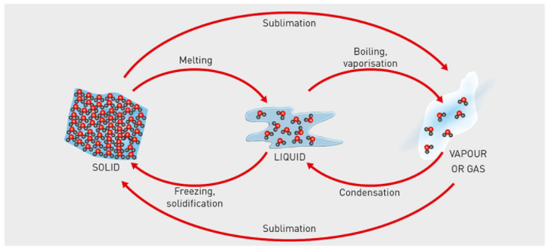
Concept Development
CFU 1
What three state changes involve an increase in heat?
Substances can change between the three states by heating or cooling.
When substances are heated, they gain energy.
INCREASING HEAT
CFU 2
What happens to the energy in a substance when it is heated?
Deposition
DECREASING HEAT

Slide 11
Concept Development
CFU 1
What three state changes involve an decrease in heat?
Substances can change between the three states by heating or cooling.
When substances are cooled, they lose energy.
INCREASING HEAT
CFU 2
What happens to the energy in a substance when it is cooled?
Deposition
DECREASING HEAT

Slide 12
Skill Development/Guided Practice
CFU 1
What is the change of state?
Describing phase changes
Name the phase change.
Describe the change in energy (increase/decrease)
CFU 2
Is the energy increasing or decreasing?
Describe how a solid becomes a liquid.
INCREASING ENERGY
A solid becomes a liquid by melting.
The energy decreases.
Deposition
DECREASING ENERGY

Slide 13
Skill Development/Guided Practice
CFU 1
What is the change of state?
Describing phase changes
Name the phase change.
Describe the change in energy (increase/decrease)
CFU 2
Is the energy increasing or decreasing?
Describe how a gas becomes a liquid.
INCREASING HEAT
A ______ becomes a ______ by ______.
The energy _______.
A gas becomes a liquid by condensation.
The energy decreases.
Deposition
DECREASING HEAT

Slide 14
Skill Development/Guided Practice
CFU 1
What is the change of state?
Describing phase changes
Name the phase change.
Describe the change in energy (increase/decrease)
CFU 2
Is the energy increasing or decreasing?
Describe how a solid becomes a gas.
INCREASING HEAT
A ______ becomes a ______ by ______.
The energy _______.
A solid becomes a gas by sublimation.
The energy increases.
Deposition
DECREASING HEAT

Slide 15
Skill Development/Guided Practice
CFU 1
What is the change of state?
Describing phase changes
Name the phase change.
Describe the change in energy (increase/decrease)
CFU 2
Is the energy increasing or decreasing?
Describe how a liquid becomes a solid.
INCREASING HEAT
A ______ becomes a ______ by ______.
The energy _______.
A liquid becomes a solid by freezing.
The energy decreases.
Deposition
DECREASING HEAT

Slide 16
Relevance
Knowing phase changes can help you predict how different substances will respond when heated or cooled.
Knowing phase changes can help you determine how to store different substances.

Slide 17
Skill Closure
Name the change of state for
1. a liquid becoming a solid 3. a liquid becoming a gas
2. a gas becoming a solid 4. a gas becoming a liquid
Skill Closure
http://www.harcourtschool.com/activity/mixture/mixture.html
http://www.harcourtschool.com/activity/mixture/mixture.html
Which three state changes involve a decrease in heat?
Skill Closure
Describe how a liquid becomes a gas.
Deposition

Slide 18
Independent Practice
Draw the picture into your books. Fill in the blanks using these words:
Deposition
Sublimation
Freezing
Boiling
Condensation
Melting
Increasing Heat
Decreasing Heat
Deposition
DECREASING HEAT
Notes:
The last question is extension only. Worked really well doing a demonstration in the class and having a group chat about what they could see.

Slide 19
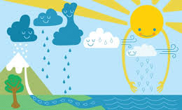
Independent Practice
The movement of water around the earth relies on different phase changes.
Fill in the blanks
3
3
2
1. Liquid water _______________ to form clouds
1
2. Clouds vapours can __________ to form rain drops
4
3. Rain drops can _____________ to form snow or ice
4. Snow or ice can _______ to form liquid water
Condense Melt Evaporate Freeze

Slide 20
Independent Practice
Decide whether you think these substances exist in two or more states of matter: computer ink, contents of an aerosol can, fog, jelly.
Group the following substances according to their state of matter as a solid, liquid, or gas: ice cream, chocolate bar, clouds, smoke, glass, honey, cake, bread, mashed potato, paper, peanut butter, alfoil, play dough, steam, slime.
Explain the meaning of these words
Vaporisation
Sublimation
Condensation
Deposition
Condensation forms on the outside of a cold container of water. Propose a series of tests or experiments that you could do to be sure that the condensation on the outside of container did not soak through from the inside of the container.
Notes:
The last question is extension only. Worked really well doing a demonstration in the class and having a group chat about what they could see.

Slide 21
Independent practice
Properties of matter
https://play.kahoot.it/#/?quizId=eb1f0178-7e93-434b-a95e-0968f6ae19db
State of Matter
https://play.kahoot.it/#/k/f2b6dee2-d6c0-463a-a64a-a6d8b0322018

